Slide 1

WeMove Head Gesture Controlled Wheelchair

Slide 2
Main goal
Provide control over a wheelchair for motion impaired individuals

Slide 3


Assumptions
Total freedom of motion for the neck and head
Constant presence of a caretaker
Disclaimer:
Just a small independence for disabled people

Slide 4

COMPONENTS
Smart-Car
1 x WeMos D1 Mini
2 x 18650 Li-Ion 4.2V 8800mAh Batteries
Smart-Hat
1 x WeMos D1 Mini
1 x LIR2023 Li-Ion 3.6V 50mAh Battery
1 x L293D Quadruple Half-H Driver Chip
2 x Geared Motors 3-12V 60Rpm
1 x Toggle Switch
1 x MPU6050 Six-Axis Accelerometer + Gyroscope Sensor
1 x TP4056 Li-Ion Battery Charger
1 x Toggle Switch

Slide 5

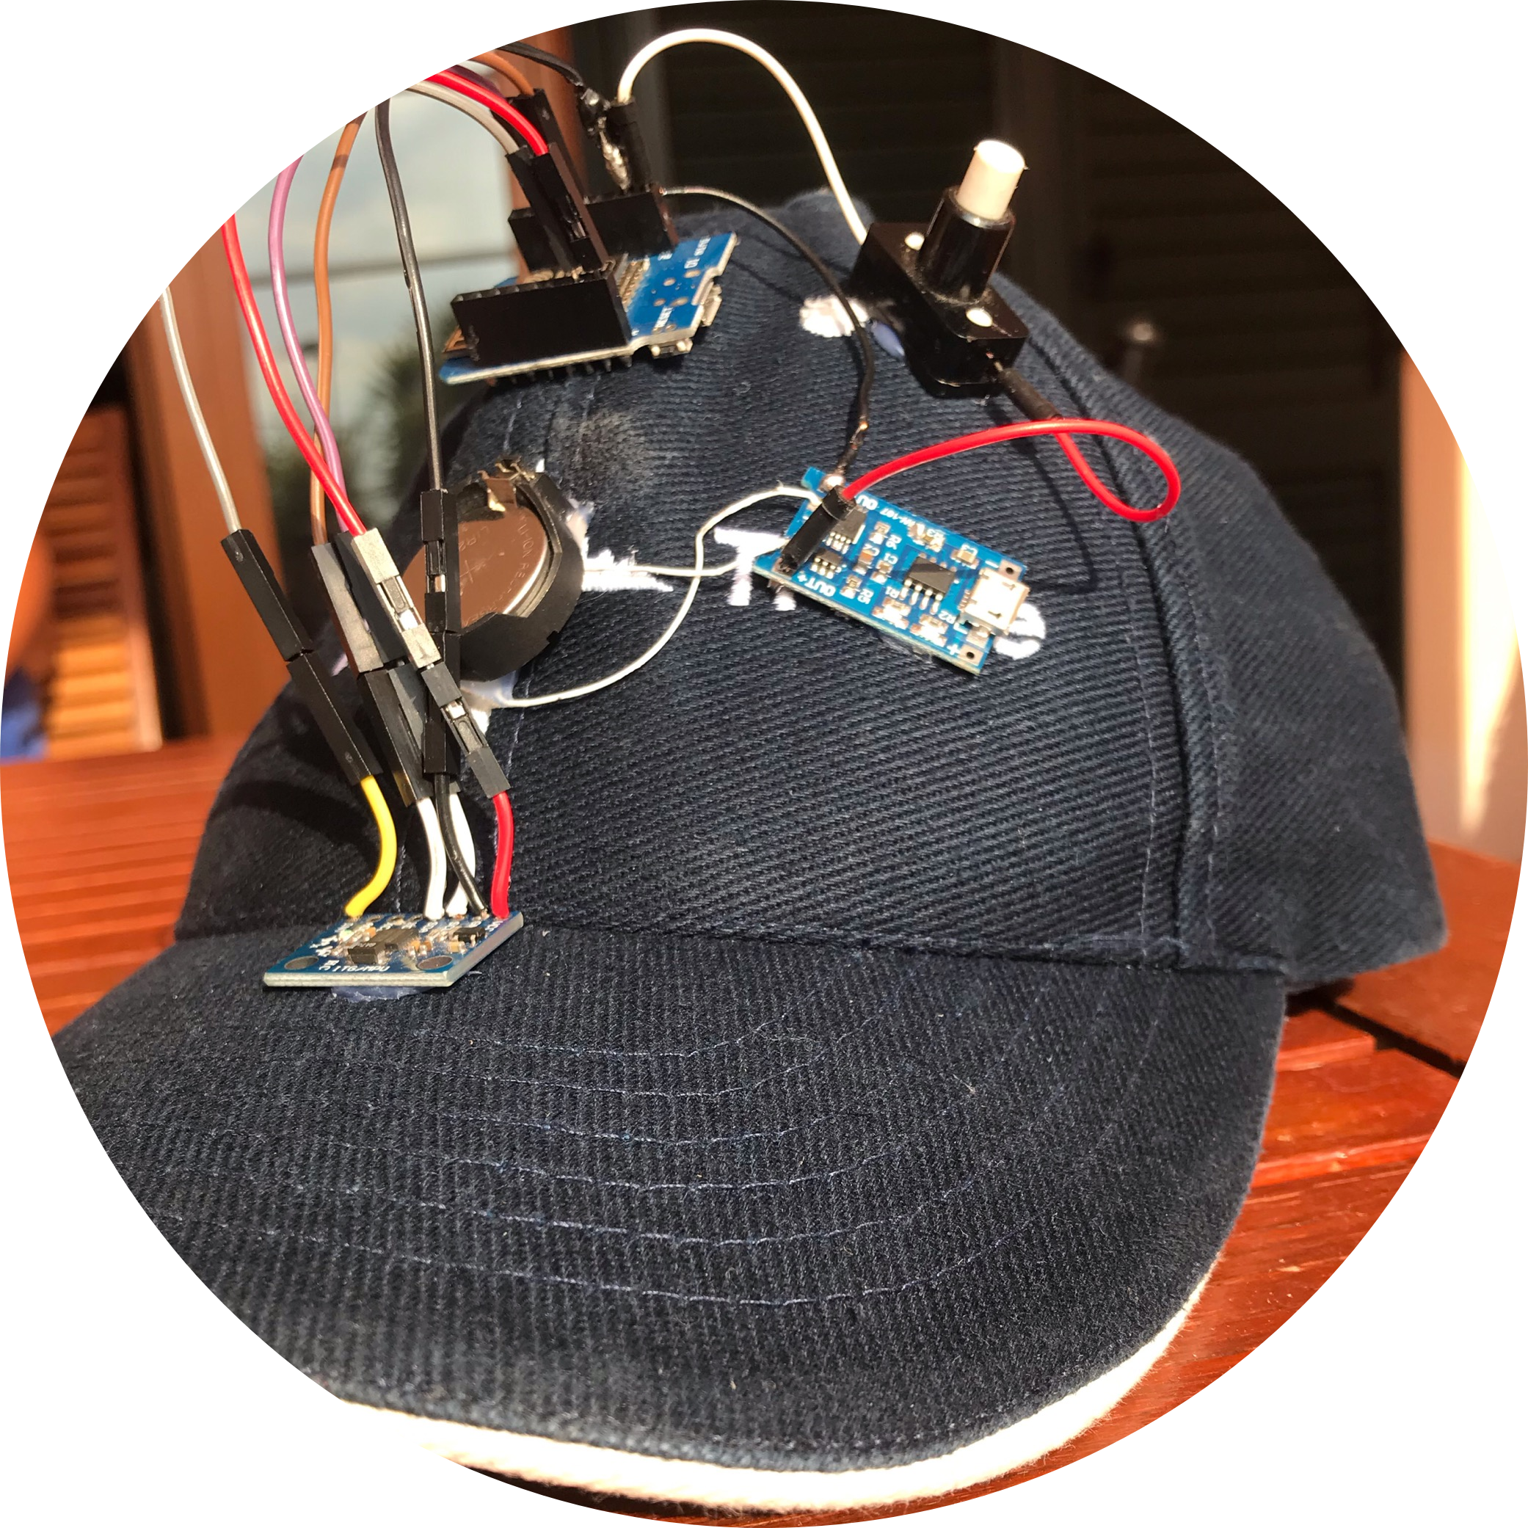
The Hat
Fully autonomous
Wi-Fi connected
Re-chargable
Battery powered

Slide 6




Motion detection
First idea: Collar
Doesn't provide wide enough angles to work with
Final idea: Hat
Leverage the longer distance from the point of rotation to get bigger angles

Slide 7

Motion Control
Necessity for gestures that are not unnatural but not too natural
Tilting the head down causes acceleration
Tilting the head laterally causes rotation
No motion assigned to tilting the head upwards
Angles thresholds for motion to start

Slide 8

20 Seconds of sensor calibration
De-bias algorithm to set the zero point at end of calibration
Alignment even if the hat is not perfectly placed
Calibration process

Slide 9
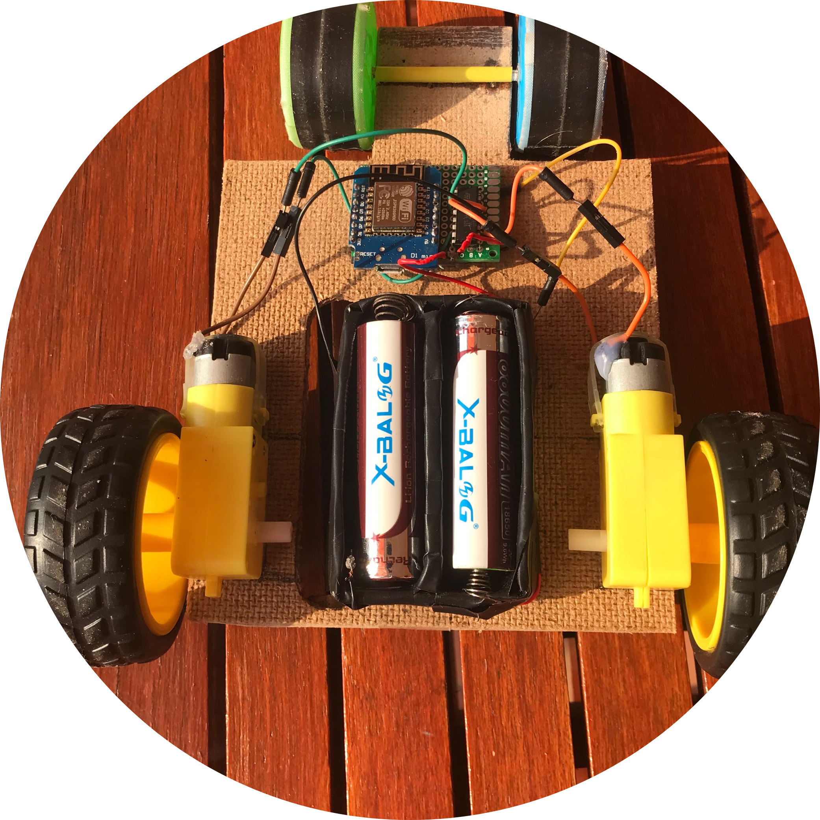
The Wheelchair
Prototype
Made by a car model
Battery powered
Wi-Fi connected

Slide 10

The model
2 front wheels joined by a fixed shaft
2 indipendent rear wheels driven by geared motors
Motors driven by l293d chip operated by microcontroller

Slide 11
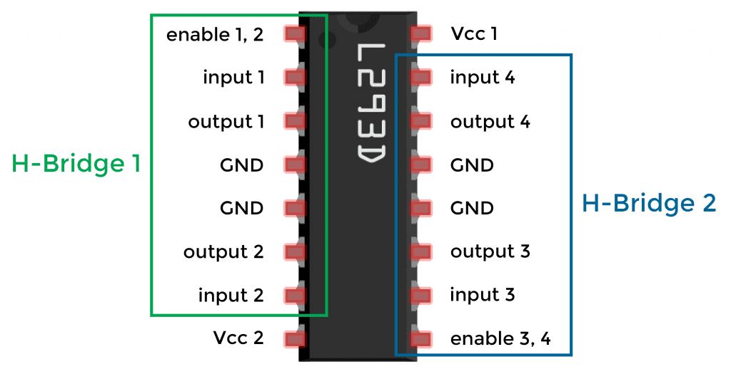

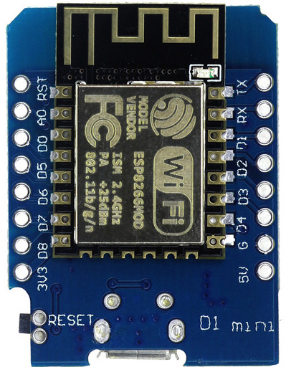
The driving circuit
L293D chip
Input pins from microcontroller
Output pins to motors
Enable pins for PWM regulation
Separated power supply for internal logic and motors
WeMos D1 Mini Microcontroller
Wi-Fi connectivity on-board
Receives data from the sensor
Produces the control output for L293D

Slide 12
The connection

Slide 13
Wired or Wireless?
Wired
Wireless
Advantages
Disadvantages
Faster response
Simpler final product
Lower production cost
Advantages
Disadvantages
Possible twists
Unwanted forces on the sensor
Lenght issues
None of wired disadvantages
More aesthetic
More stable sensor
Higher cost
Higher power consumption

Slide 14

Hat act as access point and creates network
Car act as station and connects to network
Hat writes data on local port
Car hears data incoming on local port
The
communication
Fast exchange of data
No error control
UDP Protocol
Perfect for our application

Slide 15

And… it works!

Slide 16


Future developments

Slide 17
Future developments
Stabilization process expansion:
initial average + subsequent averages at regular intervals
More possible body parts; gloves, anklets
Using more sensors and a digital camera
Gesture detection algorithms introduction
Installing the motors on a non-smart wheelchair

Slide 18
Thank you for your attention!

